Slide 1
Data Efficiency and Machine Learning
NEIL LAWRENCE
Department of Computer Science and SITraN
@lawrennd
Notes:
Challenges
Introduce self
Alphago impressive but requires heavy compute.
More games of go than any human
And yet still Lee managed to win a match.

Slide 2
GLOBAL INFORMATION STORAGE CAPACITY IN OPTIMALLY COMPRESSED BYTES
Notes:
Superhuman performances are being driven by ML
Vision, Speech, Translation
Lots of process, but driven by availability of data.
Methodologies have not progressed a great deal since late 1990s

Slide 3
Notes:
Historical Analogy
Thomas Newcomen South West England
1712 Steam Engine

Slide 4
Coal
Google
Facebook
Amazon
Tin
Startups

Slide 5
Notes:
James Watt Separate Condensor 1760s

Slide 6
Outline of the DeepFace architecture. A front-end of a single convolution-pooling-convolution filtering on the rectified input, followed by three locally-connected layers and two fully-connected layers. Color illustrates feature maps produced at each layer. The net includes more than 120 million parameters, where more than 95% come from the local and fully connected layers.
Source: DeepFace
Notes:
Modern Inference Engine
120 million parameters, 1 billion images, near human performance

Slide 7
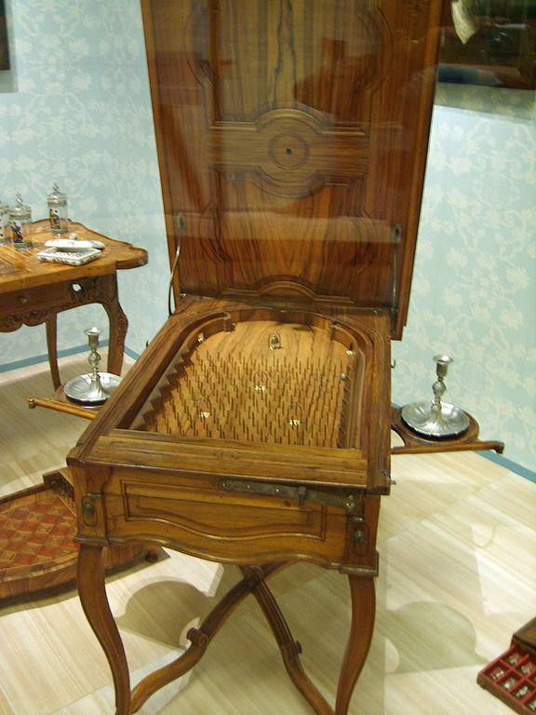
Notes:
Internal structure of the machine like layers of pins
Initial state of machine.
Moving pins around to fix

Slide 8
Yes
No

Slide 9
Yes
No

Slide 10
B
A
Notes:
All possible paths!

Slide 11
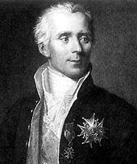

Slide 12
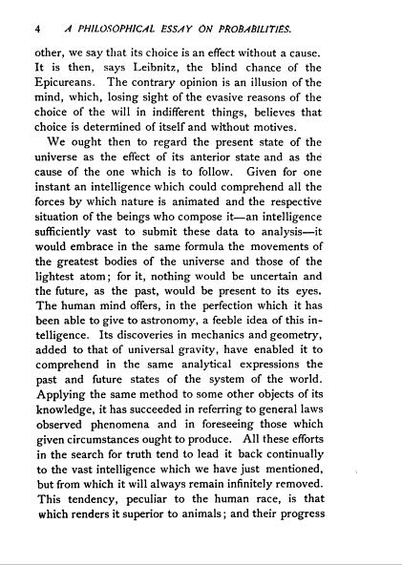
Notes:
On this slide and next two I’ll review Laplace’s perspective which was that we should use probability to deal with our state of ignorance. Probability as a means of abstraction across the scales.

Slide 13
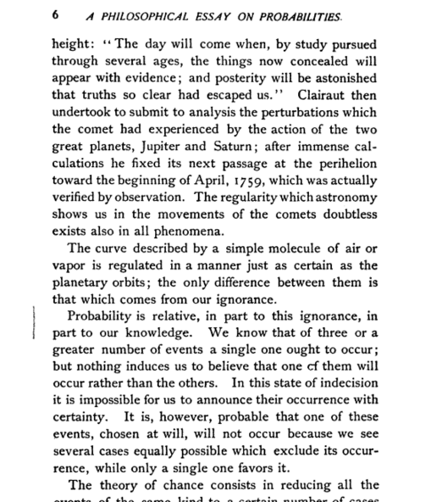

Slide 14
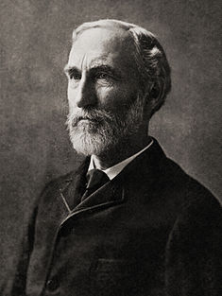
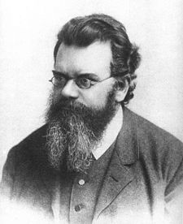

Slide 17
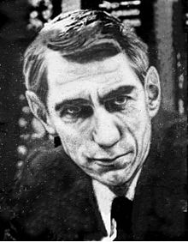

"My greatest concern was what to call it. I thought of calling it ‘information’, but the word was overly used, so I decided to call it ‘uncertainty’. When I discussed it with John von Neumann, he had a better idea. Von Neumann told me, ‘You should call it entropy, for two reasons. In the first place your uncertainty function has been used in statistical mechanics under that name, so it already has a name. In the second place, and more important, nobody knows what entropy really is, so in a debate you will always have the advantage.“
(HT Alex Matthews)

Slide 18
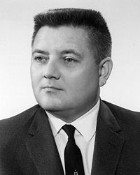
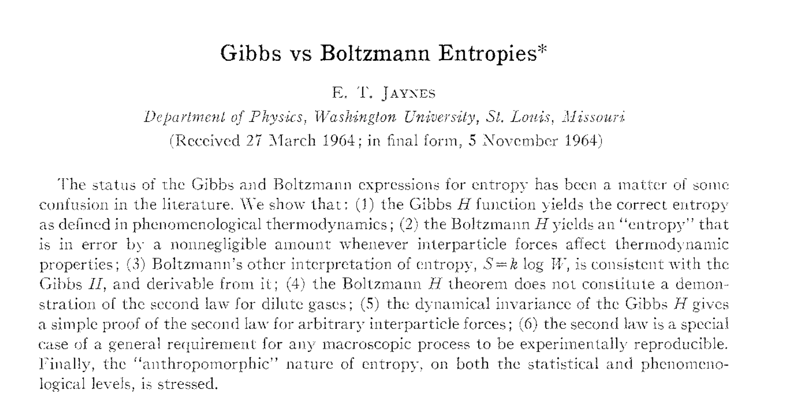

Slide 19
Take precisely stated prior data or testable information about a probability distribution function. Consider the set of all trial probability distributions that would encode the prior data. Of those, the one with maximal information entropy is the proper distribution, according to this principle.
maximum entropy
principle of indifference

Slide 20
Thank you
Neil Lawrence
http://inverseprobability.com
@lawrennd
Notes:
Thank you.

